Slide 1
Handwriting
Handwriting analysis involves two phases:
The hardware—ink, paper, pens, pencils, typewriter, printers
Visual examination of the writing

Slide 2
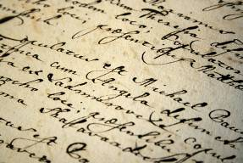
Handwriting Characteristics
Line quality
Word and letter spacing
Letter comparison
Pen lifts
Connecting strokes
Beginning and ending strokes
Unusual letter formation
Shading or pen pressure
Slant
Baseline habits
Flourishes or embellishments
Diacritic placement

Slide 3
Handwriting Identification
Analysis of the known writing with a determination of the characteristics found in the known
Analysis of the questioned or unknown writing and determination of its characteristics
Comparison of the questioned writing with the known writing
Evaluation of the evidence, including the similarities and dissimilarities between the questioned and known writing
The document examiner must have enough exemplars to make a determination of whether or not the two samples match.

Slide 4
Handwriting Samples
The subject should not be shown the questioned document.
The subject is not told how to spell words or use punctuation.
The subject should use materials similar to those of the document.
The dictated text should match some parts of the document.
The subject should be asked to sign the text.
Always have a witness.

Slide 6
Hand writing: Individual or Class evidence?
Class Characteristics:
Features and dimensions of letters.
Connection of letters to each other
Capitalization
Punctuation
Individual Characteristics:
Unique features of letters.
Is the letter “O” open or closed
Is the “n”written with a pointed tip

Slide 7
Basic characteristics for comparing Handwriting
Overall Form
The size, shape, slant, and strokes of the letters
Line Features
Writing speed, pen pressure, spacing between letters and words and how the letters are connected.
Margins and Format
Content
Grammar, punctuation and word choice

Slide 8
Methods of Forgery
Simulated forgery—one made by copying a genuine signature
Traced forgery—one made by tracing a genuine signature
Blind forgery—one made without a model of the signature

Slide 9
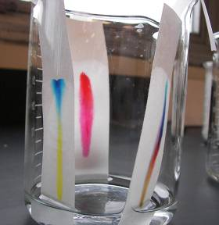
Ink
Chromatography is a method of physically separating the components of inks.

Slide 10
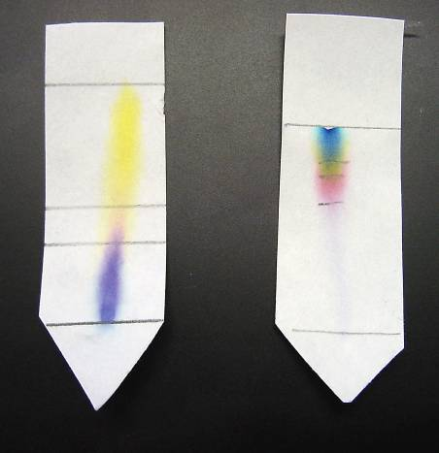
Paper Chromatography of Ink
Two samples of black ink from two different manufacturers have been characterized using paper chromatography.

