Slide 1
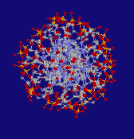
Gel Electrophoresis of DNA

Slide 2
DNA as Forensic Evidence
Individual evidence – identify a single person
Trace evidence – small amount left at crime scene
Found in saliva, blood, semen, skin, hair roots, urine (nuclear DNA)
Hair, bones, teeth (mtDNA)

Slide 3
Collection of DNA
Avoid contamination
Wear gloves, avoid sneezing or coughing
Preserve carefully
Air-dry samples
If wet, store in freezer

Slide 4
What is DNA??

Slide 5
Basic DNA Facts:
Stores genetic information
Tightly coiled to form chromosomes
deoxyribonucleic acid
4 nitrogen bases: A (adenine), G (guanine), C (cytosine), T (thymine)
Double-stranded

Slide 6
Chromosomes
Each person has 46 chromosomes
23 pairs – 1 set from mom, 1 set from dad
Genes: segment of DNA that contains info to produce a protein
Allele: alternate forms of a gene
Inherit 1 allele from mom, 1 allele from dad

Slide 7
What is Gel Electrophoresis?
Electro = flow of electricity, phoresis, from the Greek = to carry across
A gel is a colloid, a suspension of tiny particles in a medium, occurring in a solid form, like gelatin

Slide 8
What is Gel Electrophoresis?
Gel electrophoresis refers to the separation of charged particles located in a gel when an electric current is applied
Charged particles can include DNA, amino acids, peptides, etc

Slide 9
Why do gel electrophoresis?
When DNA is cut by restriction enzymes, the result is a mix of pieces of DNA of different lengths
Restriction Enzyme: (An enzyme from bacteria that can recognize specific base sequences in DNA and cut the DNA at that site (the restriction site). A restriction enzyme acts as a biochemical scissors.

Slide 10
Why do gel Electrophoresis?
It is useful to be able to separate the pieces - I.e. for recovering particular pieces of DNA, for forensic work or for sequencing

Slide 11
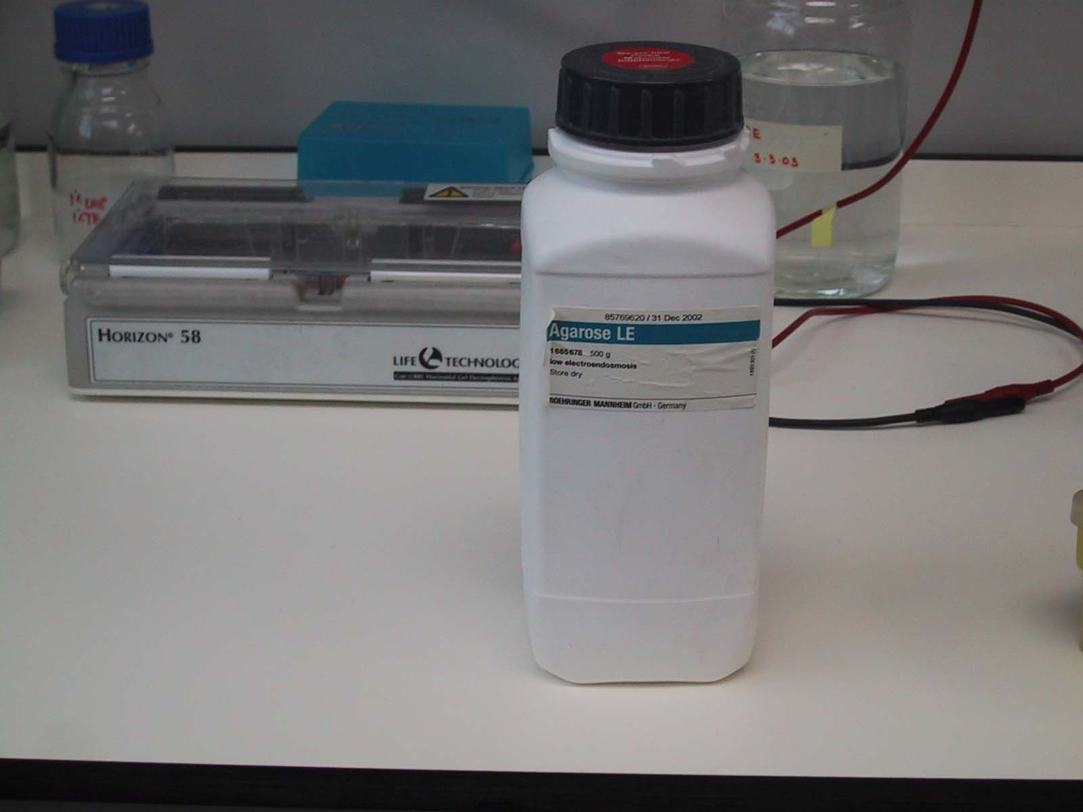
What is needed?
Agarose - a polysaccharide made from seaweed. Agarose is dissolved in buffer and heated, then cools to a gelatinous solid with a network of crosslinked molecules

Slide 12
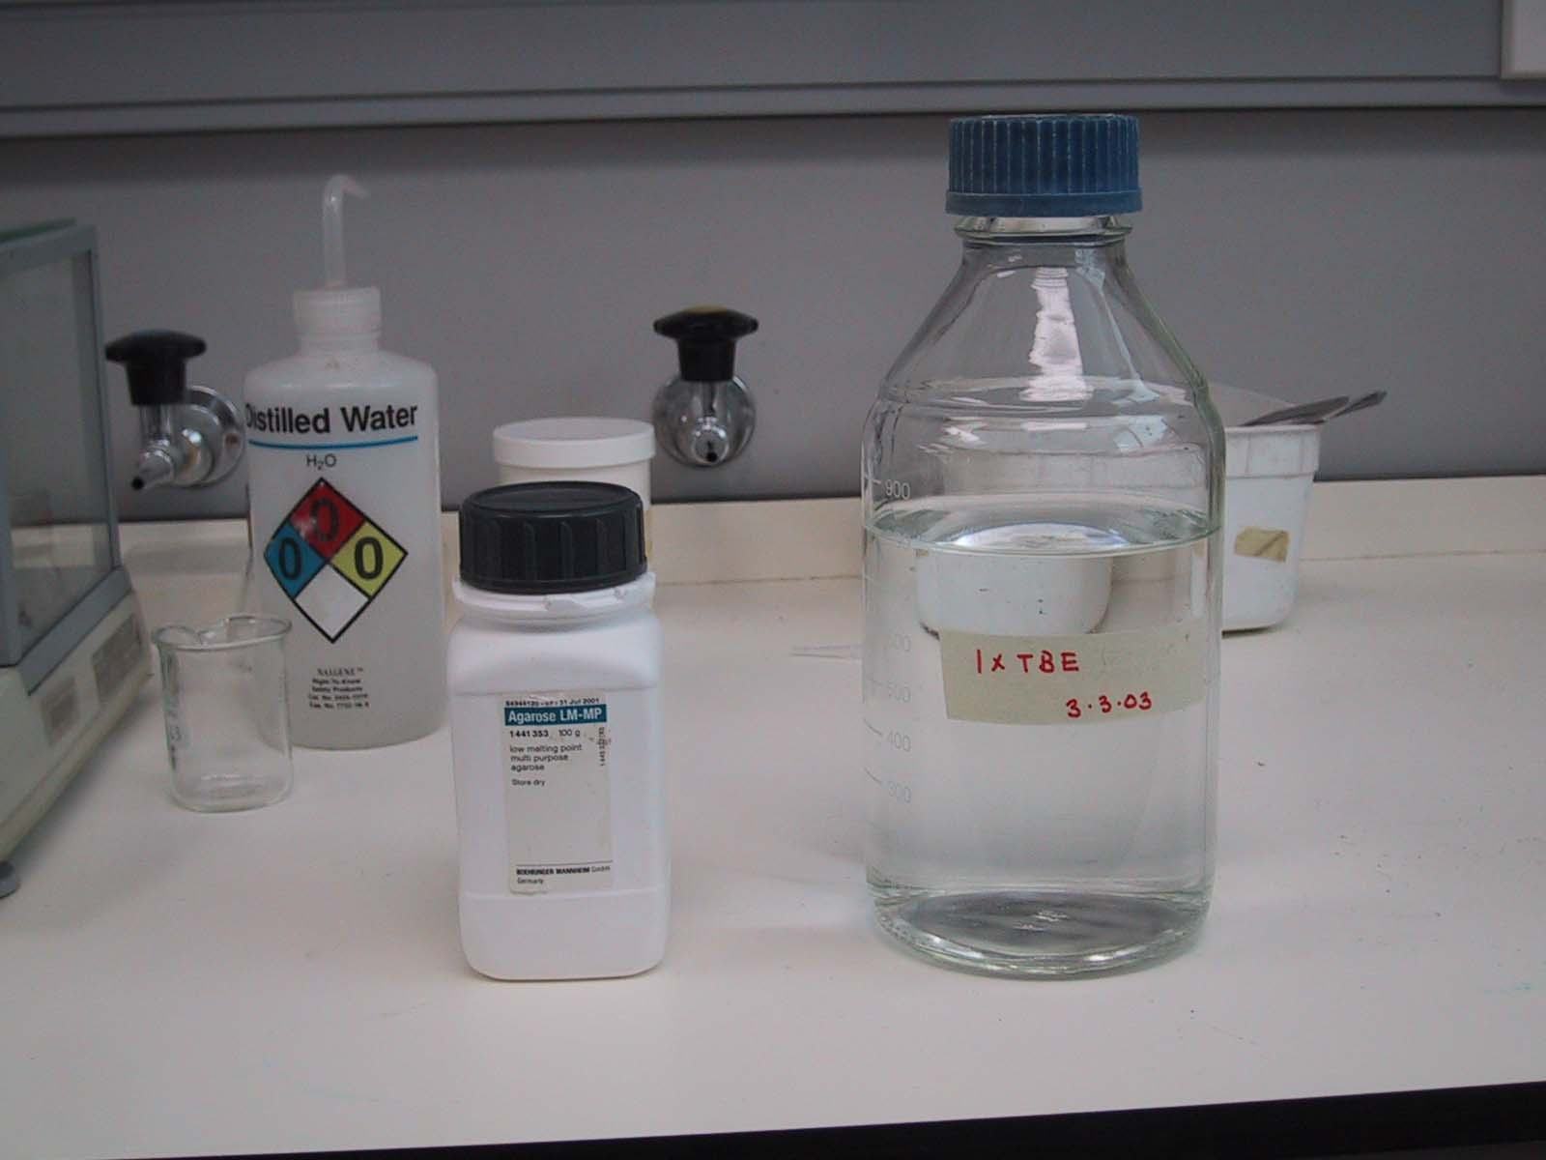
Buffer - in this case TBE
The buffer provides ions in solution to ensure electrical conductivity.

Slide 13
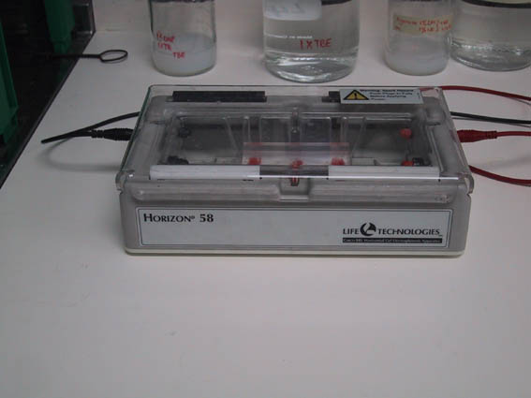
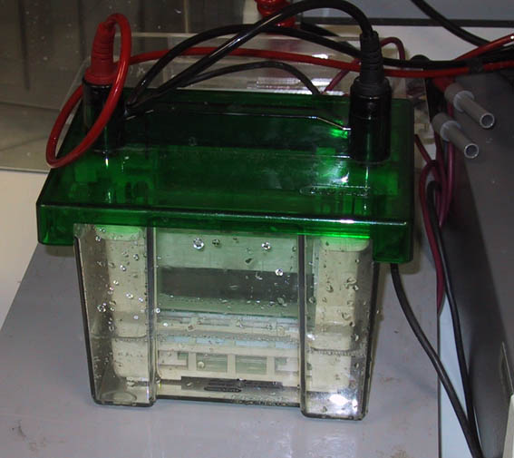
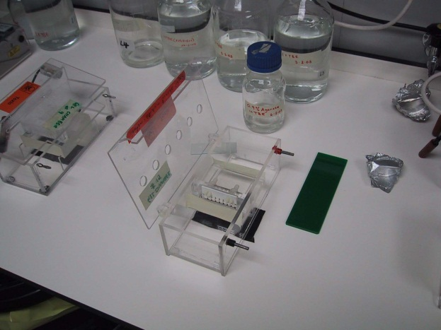
Also needed are a power supply and a gel chamber
Gel chambers come in a variety of models, from commercial through home-made, and a variety of sizes

Slide 14
How does it work?
DNA is an organic acid, and is negatively charged (remember, DNA for Negative)
When the DNA is exposed to an electrical field, the particles migrate toward the positive electrode
Smaller pieces of DNA can travel further in a given time than larger pieces

Slide 15
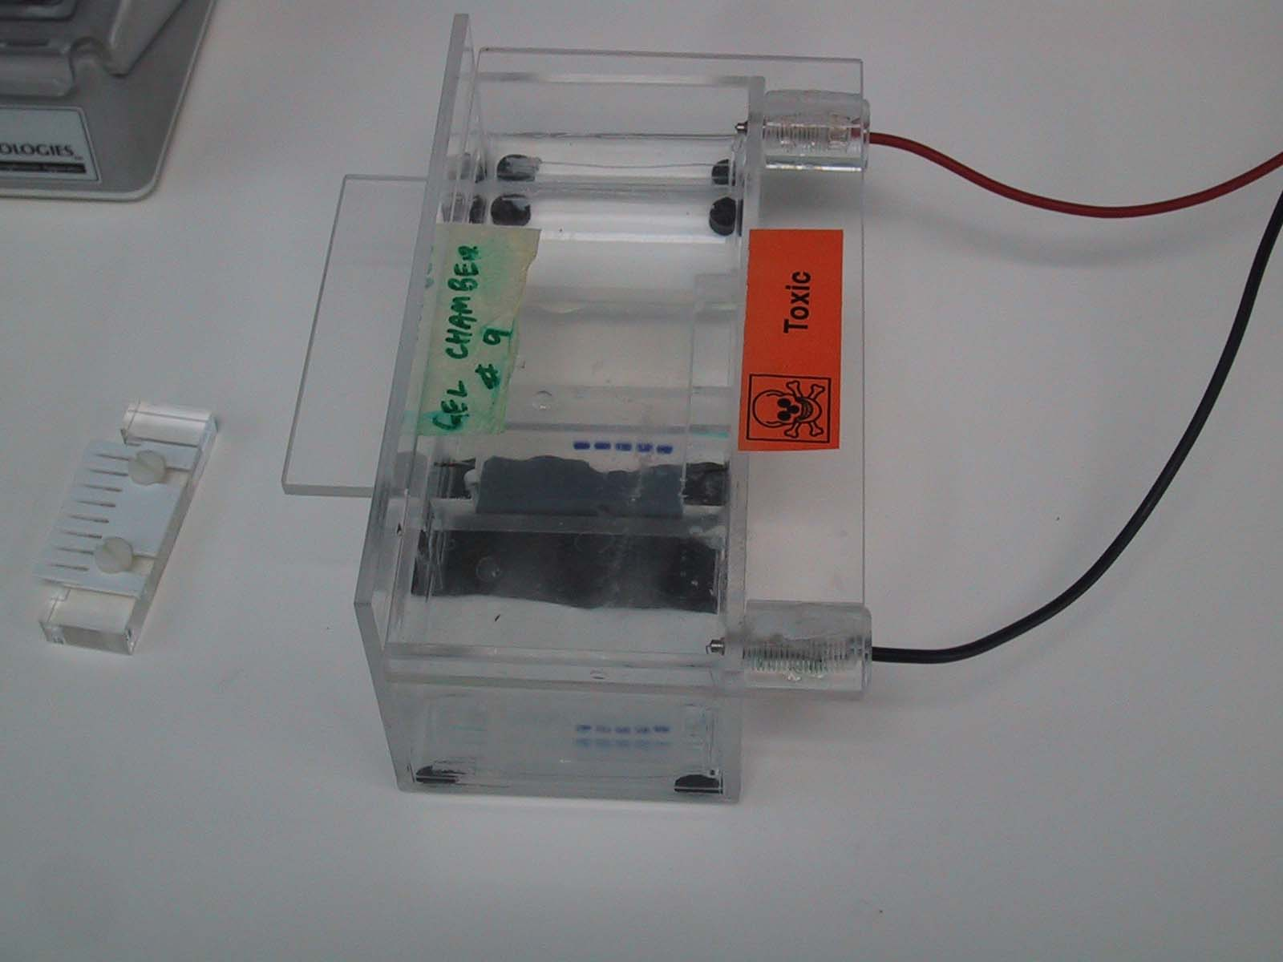
A gel being run
Positive electrode
Comb
Agarose block
DNA loaded in
wells in the agarose
Buffer
Black background
To make loading wells easier

Slide 16
Steps in running a gel
DNA is prepared by digestion with restriction enzymes
Agarose is made to an appropriate thickness (the higher the % agarose, the slower the big fragments run) and ‘melted’ in the microwave
The gel chamber is set up, the ‘comb’ is inserted
The agarose may have a DNA ‘dye’ added (or it may be stained later). The agarose is poured onto the gel block and cooled

Slide 17
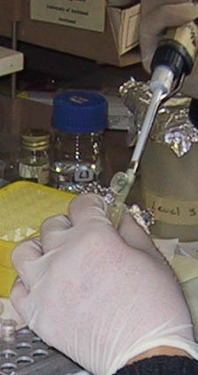
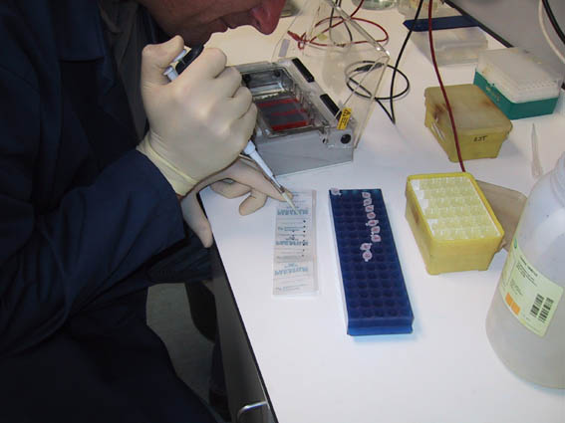
The comb is removed, leaving little ‘wells’ and buffer is poured over the gel to cover it completely
The DNA samples are mixed with a dense loading dye so they sink into their wells and can be seen

Slide 18
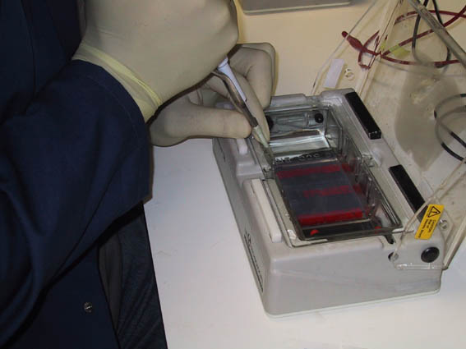
The DNA samples are put in the wells with a micropipette.
Micropipettes have disposable tips and can accurately measure 1/1,000,000 of a litre

Slide 19
Next?
The power source is turned on and the gel is run. The time of the run depends upon the amount of current and % gel, and requires experimentation
At the end of the run the gel is removed (it is actually quite stiff)
The gel is then visualized - UV light causes the bands of DNA to fluoresce

Slide 20
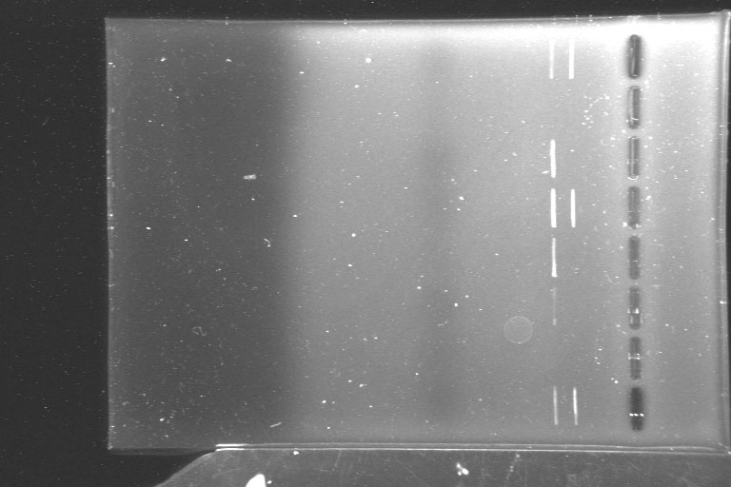
A gel as seen under UV light - some samples had 2 fragments
of DNA, while others had none or one

Slide 21
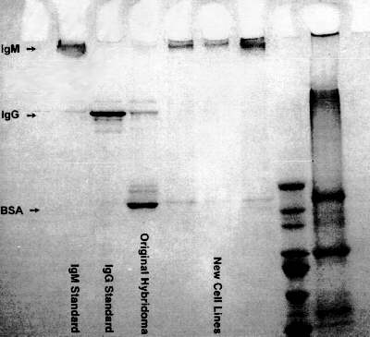
More……
Many samples can be run on one gel- but it is important to keep track
Most gels have one lane as a ‘DNA ladder’ - DNA fragments of known size are used for comparison

Slide 22
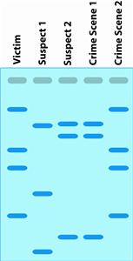
Crime Scene Matching (To establish identity – all bands must match)

Slide 23
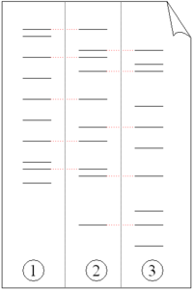
Paternity
Mom
Child
Dad
A child inherits 1 set of genes from mom, 1 set from dad
½ of the bands in a pattern are from mom; the other ½ from dad

Slide 24
Next
Please Read Pre-Lab and Complete
Read Lab and discuss steps with partner

