Slide 1
The Cafeteria Mystery Lesson II
Enzymes and Indiators

Slide 2
Recall in the Mystery
Mathew D. Mentioned he thought a suspicious underground club of nerds may have completed the crime.
We suspected this because the trophy case was vandalized, and the cafeteria vandalism was characteristic.

Slide 3
The Running Theory
As we read on the “Philophiles” website, the initiation process stated some important steps
1. Eat raw liver
2. Drink 12 cans of soda
3 Be Blond
4. Make Philos proud ( believed to be done so with vandalism)

Slide 4
So.....
If we suspect this crime was part of the Philophile’s initiation, we need to prove it with evidence found at the crime scene.

Slide 5
The Vomit
Forensic investigators often analyze stomach contents during an autopsy.
Stomach content can be tested for toxins.
We can use chemical indicators and enzymes to detect the presence of organic substances in the vomit.

Slide 6
What organic substances might we look for?
Carbohydrates can be easily identified, but there are a few different kinds
Proteins and liver specifically can also be identified

Slide 7
First, a look at some Sugar!
Sources of Carbohydrates
Simple Sugars
Complex Carbohydrates
Dietary Fiber

Slide 8
Carbohydrates
Simple Carbohydrates
monosaccharides
disaccharides
Complex Carbohydrates
oligosaccharides
polysaccharides
glycogen
starches
fibers

Slide 9
Monosaccharides: Single Sugars
Glucose
carbohydrate form used by the body, referred to as “blood sugar”
basic sub-unit of other larger carbohydrate molecules
found in fruits, vegetables, honey

Slide 10
Monosaccharides: Single Sugars
Fructose
sweetest of the sugars
occurs naturally in fruits & honey, “fruit sugar”
combines with glucose to form sucrose
Galactose
combines with glucose to form lactose, “milk sugar”

Slide 11
Disaccharides
Sucrose (“table sugar”)
glucose + fructose
Lactose (“milk sugar”)
glucose + galactose
Maltose (“malt sugar”)
glucose + glucose

Slide 12
Complex Carbohydrates
Oligosaccharides
short carbohydrate chains of 3 - 10 monosaccharides
found in legumes and human milk
Examples:
raffinose
stachyose
cannot be broken down by human enzymes, though can be digested by colonic bacteria

Slide 13
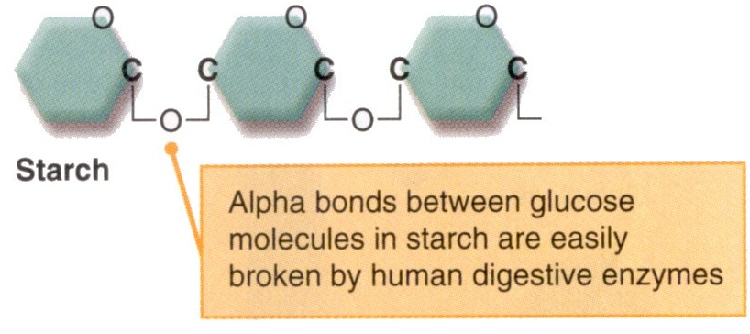
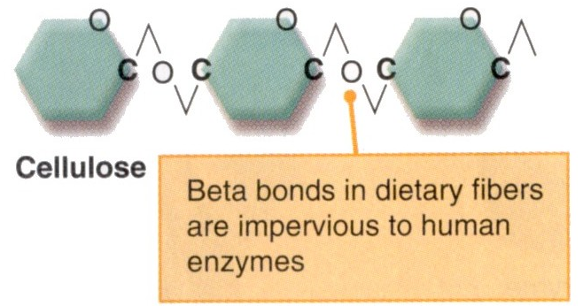
Complex Carbohydrates
Polysaccharides
long carbohydrate chains of monosaccharides linked by glycosidic bonds
alpha (α) bonds (starch)
beta (β) bonds (found in fiber)

Slide 14
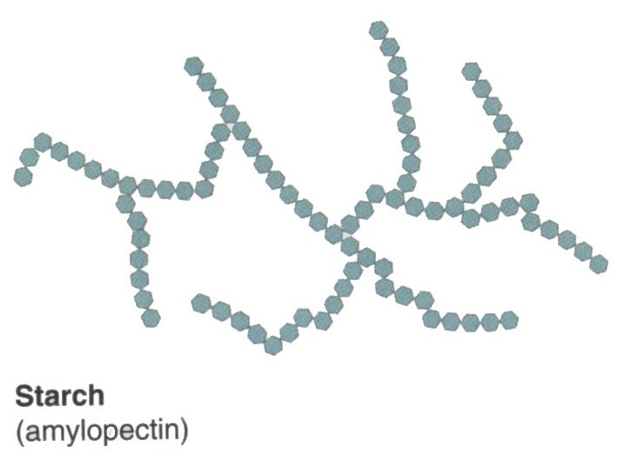
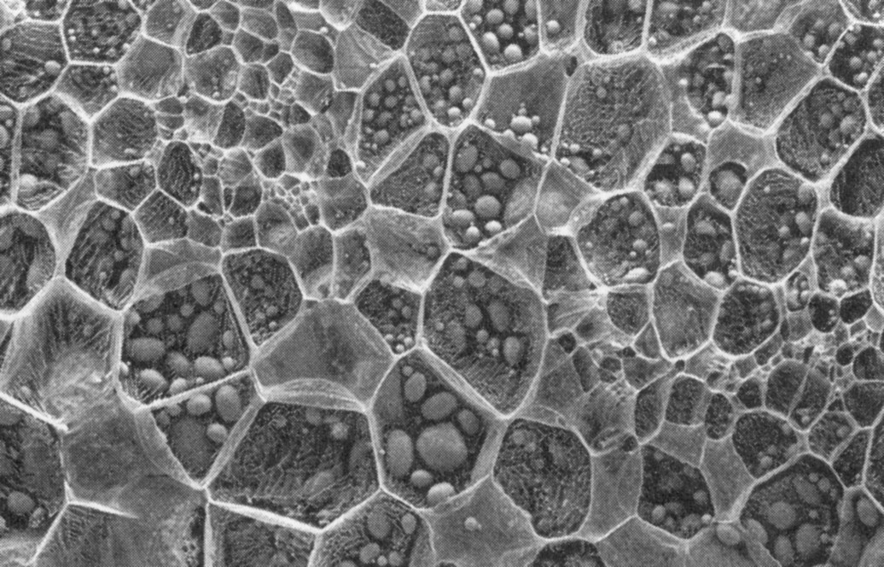
Complex Carbohydrates
amylose
Starch
plant storage form of carbohydrate
long branched or unbranched chains of glucose
amylose
amylopectin
amylopectin

Slide 15
What is an Indicator
An indicator is a chemical compound that changes color and structure when exposed to certain conditions and is useful for chemical tests.
Litmus, for example, is an indicator that becomes red in the presence of acids and blue in the presence of bases.

Slide 16
Some Common Indicators
Benedict Solution is a blue liquid that turns green in a small amount of MONOSACCHARIDE yellow in larger amount of monosaccharide, and orange or red in a great amount of monosaccharide
Iodine is an orange liquid that turns blue or black in the presence of a Polysaccharide

Slide 17
Indicators Continued
Biuret reagent is a blue liquid that turns lavender to violet in the presence of a protein

Slide 18
Testing for Presence of Liver Using Enzymes
Firstly, what is an enzyme?
Enzymes catalyze chemical reactions

Slide 19
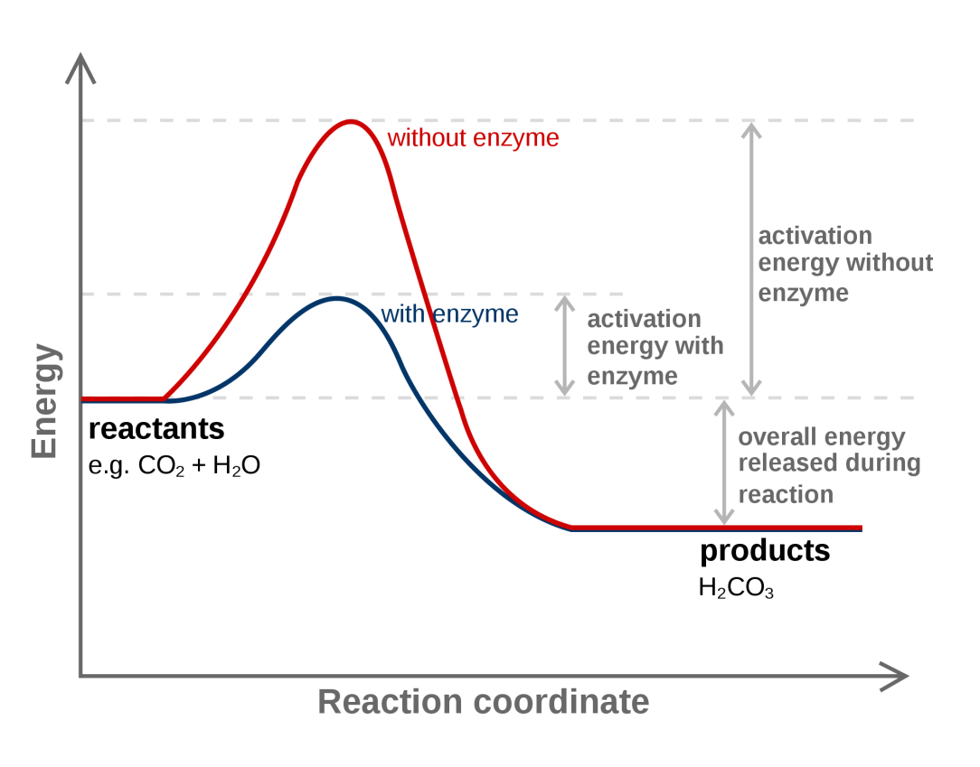
Catalyst - Speeds up chemical reactions in living organisms by decreasing the energy needed to start the reaction (activation energy)

Slide 20
Substrate- monomers that bind to the active site of an enzyme
Active site- area on enzyme where substrate binds
Product- what the enzyme produces

Slide 21
Lock and Key Model
Two substrates
Enzyme
Active site of the enzyme

Slide 22
Lock and Key Model
The substrates fit like a key in a lock
Enzyme
The active site is like a lock

Slide 23
Lock and Key Model
The activation energy for these substrates to bind together has been lowered by the enzyme.
Chemical reaction!!!
Enzyme

Slide 24
Basic Enzyme Diagram
The substrates have reacted and changed into the product
Enzyme is unchanged
Active site

Slide 25
What Enzyme Can be Detected in Liver?
The enzyme Peroxidase is located througout the body, but is plentiful in the liver.
Peroxidase is an enzyme that works to break apart Hydrogen Peroxide ( a bi-product of metabolism) and produces Water and Oxygen

Slide 26
So....
So we can use this abundant enzyme to indicate the presence of liver.
Adding Hydrogen Peroxide to liver should do what.....?
DEMO

Slide 27
Whew!
Time to read part one of the lab!

