Slide 1
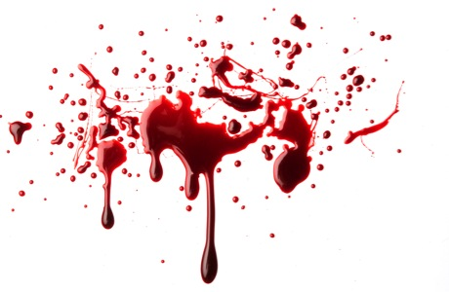
Blood Spatter Analysis

Slide 2
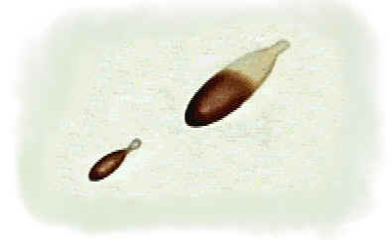
Blood Spatter
Used to explain events at a violent crime scene
Direction blood travels
Angle of impact
Blood velocity (manner of death)
Point of origin

Slide 3
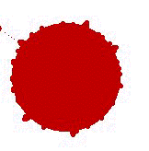
Physical Properties
Cohesion - blood sticks together as it falls
Gravity - pulls blood downward
Surface tension - blood drops that fall on a flat surface have a curved surface
Edges may have spikes or extensions
Satellites - small secondary droplets

Slide 4
6 patterns of blood spatter
Passive fall (90º angle to floor)– circular drops w/secondary satellites
Arterial spurts or gushes
Splashes – show position of victim
Smears – bleeding victim touching walls or furniture
Blood Trails – victim moving from one place to another
Blood Pools – victim bleeds heavily

Slide 5
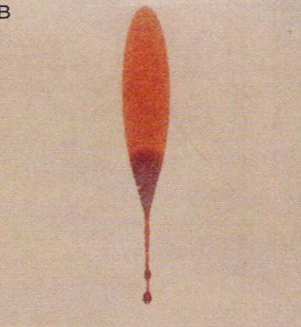
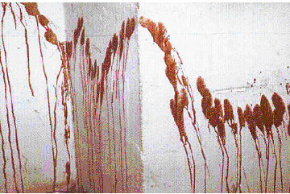
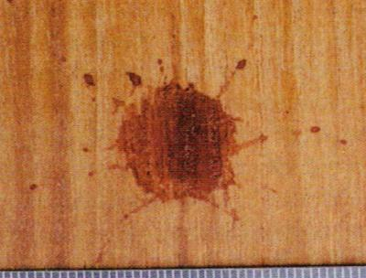
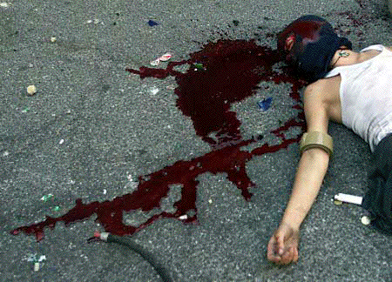
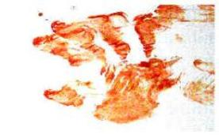
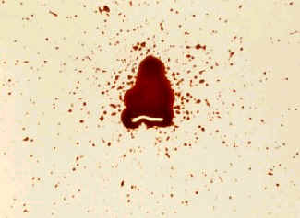
arterial spurts
splash
passive fall
blood pool
multiple drips
smear

Slide 6
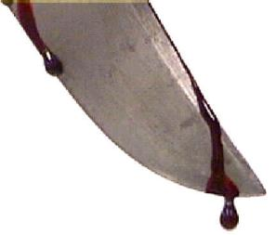
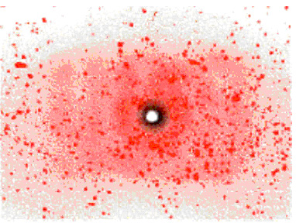
Cast off pattern: blood from a moving object coated in blood (pipe, knife)
Fine-mist spatter: high-velocity impact (gunshot)
Void: empty space; victim/attacker/object moved after attack

Slide 7
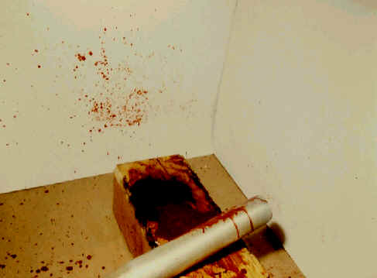
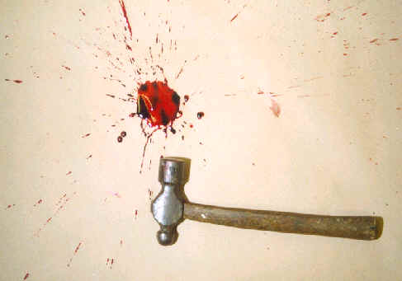
Blood Spatter Types
High velocity – gunshot wounds
Medium velocity – beating, stabbing
Low velocity – blunt object impact

Slide 8
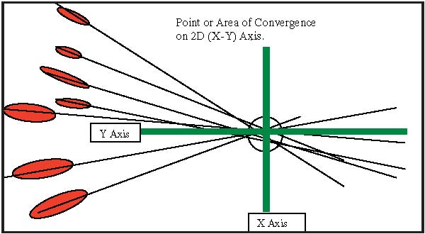
Lines of Convergence
Determine source of blood (point of origin)
Draw straight lines down long axis of blood spatter

Slide 9
Video
Blood Spatter 101

Slide 10
